Slide 1
abila Lailika Amalia
Updated Feb 2023
Hi, I am
N
N
Welcome to my PERSONAL PORTFOLIO
DATA ANALYST PORTFOLIO
DATA ANALYST PORTFOLIO

Slide 2

About Me
Page 02 of 21
A
Hello, I'm Nabila, a fresh informatics engineering graduate who is interested in Data Analytics. I enjoy exploring the world of data, math and solving issues. I'm proficient with Excel, Python, MySQL, and data visualization. Eagerness to learn new things and positively contribute to assigned project
Notes:
1) How did you get started with the field of data analysis?
2) What aspect of data intrigues you the most?
3) What are your areas of interest with respect to data analytics?

Slide 3
My Resume
Page 03 of 21
EXPERIENCE
EDUCATION
Nov 2021 - Jan 2022
2018 - 2023
PT. Mitra Prima Utama
UIN Syarif Hidayatullah Jakarta
Front-End Web Developer
Bachelor Degree in Informatics Engineering,
Grade: 3.82/4.00
Aug 2021 - Nov 2021
Tau Data Indonesia
Content Creator
April 2021 - Sep 2021
The 9th International Conference on Cyber and IT Service Management
Journal Editor

Slide 4





Personal Skill
Ms. Excel & Spreadsheet
Programming Language
Python and MySQL
Pivot Table/Power Query
Statistics
Data Visualization
Data Exploration (EDA),
Descriptive Statistic, Correlation Analysis, Clustering
Page 04 of 21

Slide 5

Bank Marketing Campaign
PERSONAL PROJECT
PERSONAL PROJECT
B
Page 05 of 21

Slide 6
Project Outline
Page 06 of 21
1.
3.
Data
Understanding
Data Insight
2.
4.
Scop
of Problem
Recommendation

Slide 7
01 Data Understanding
About Data
Bank Client Data:
This is the classic marketing bank dataset uploaded originally in the UCI Machine Learning Repository. The dataset contains information about a financial institution's marketing campaign, which you must analyze in order to uncover ways to improve future marketing efforts for the bank..
age: (numeric)
job: type of job (categorical)
marital: marital status (categorical)
education: (categorical)
default: has credit in default? (categorical)
housing: has housing loan? (categorical)
loan: has personal loan? (categorical)
balance: Balance of the individual.
Page 07 of 21

Slide 8
Page 08 of 21
Other attributes:
Related with the last contact of the current campaign:
campaign: number of contacts performed during this campaign and for this client (numeric, includes last contact)
pdays: number of days that passed by after the client was last contacted from a previous campaign (numeric)
previous: number of contacts performed before this campaign and for this client (numeric)
poutcome: outcome of the previous marketing campaign (categorical)
contact: contact communication type (categorical)
month: last contact month of year (categorical)
day: last contact day of the week (categorical)
duration: last contact duration, in seconds (numeric)
Output variable (desired target):
y : has the client subscribed a term deposit? (binary: 'yes','no')

Slide 9
Scop of Problem 02
Find the best strategies to improve for the next marketing campaign.
How can the financial institution have a greater effectiveness for future marketing campaigns?
In order to answer this, we have to analyze the last marketing campaign the bank performed and identify the patterns that will help us find conclusions in order to develop future strategies.
Page 09 of 21

Slide 10
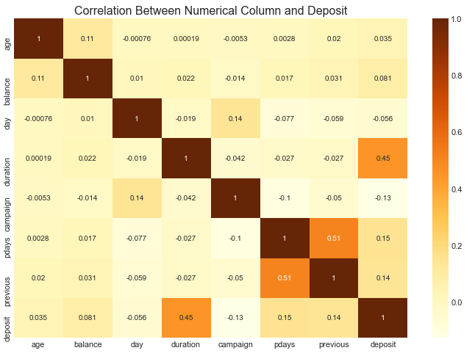
There is correlation between last contact duration with term deposits
Meaning the higher the duration, the more likely it is for a client to open a term deposit.
By understanding this, we could take this into considderation when making decision towards Next Marketing Campaign
Page 10 of 21

Slide 11
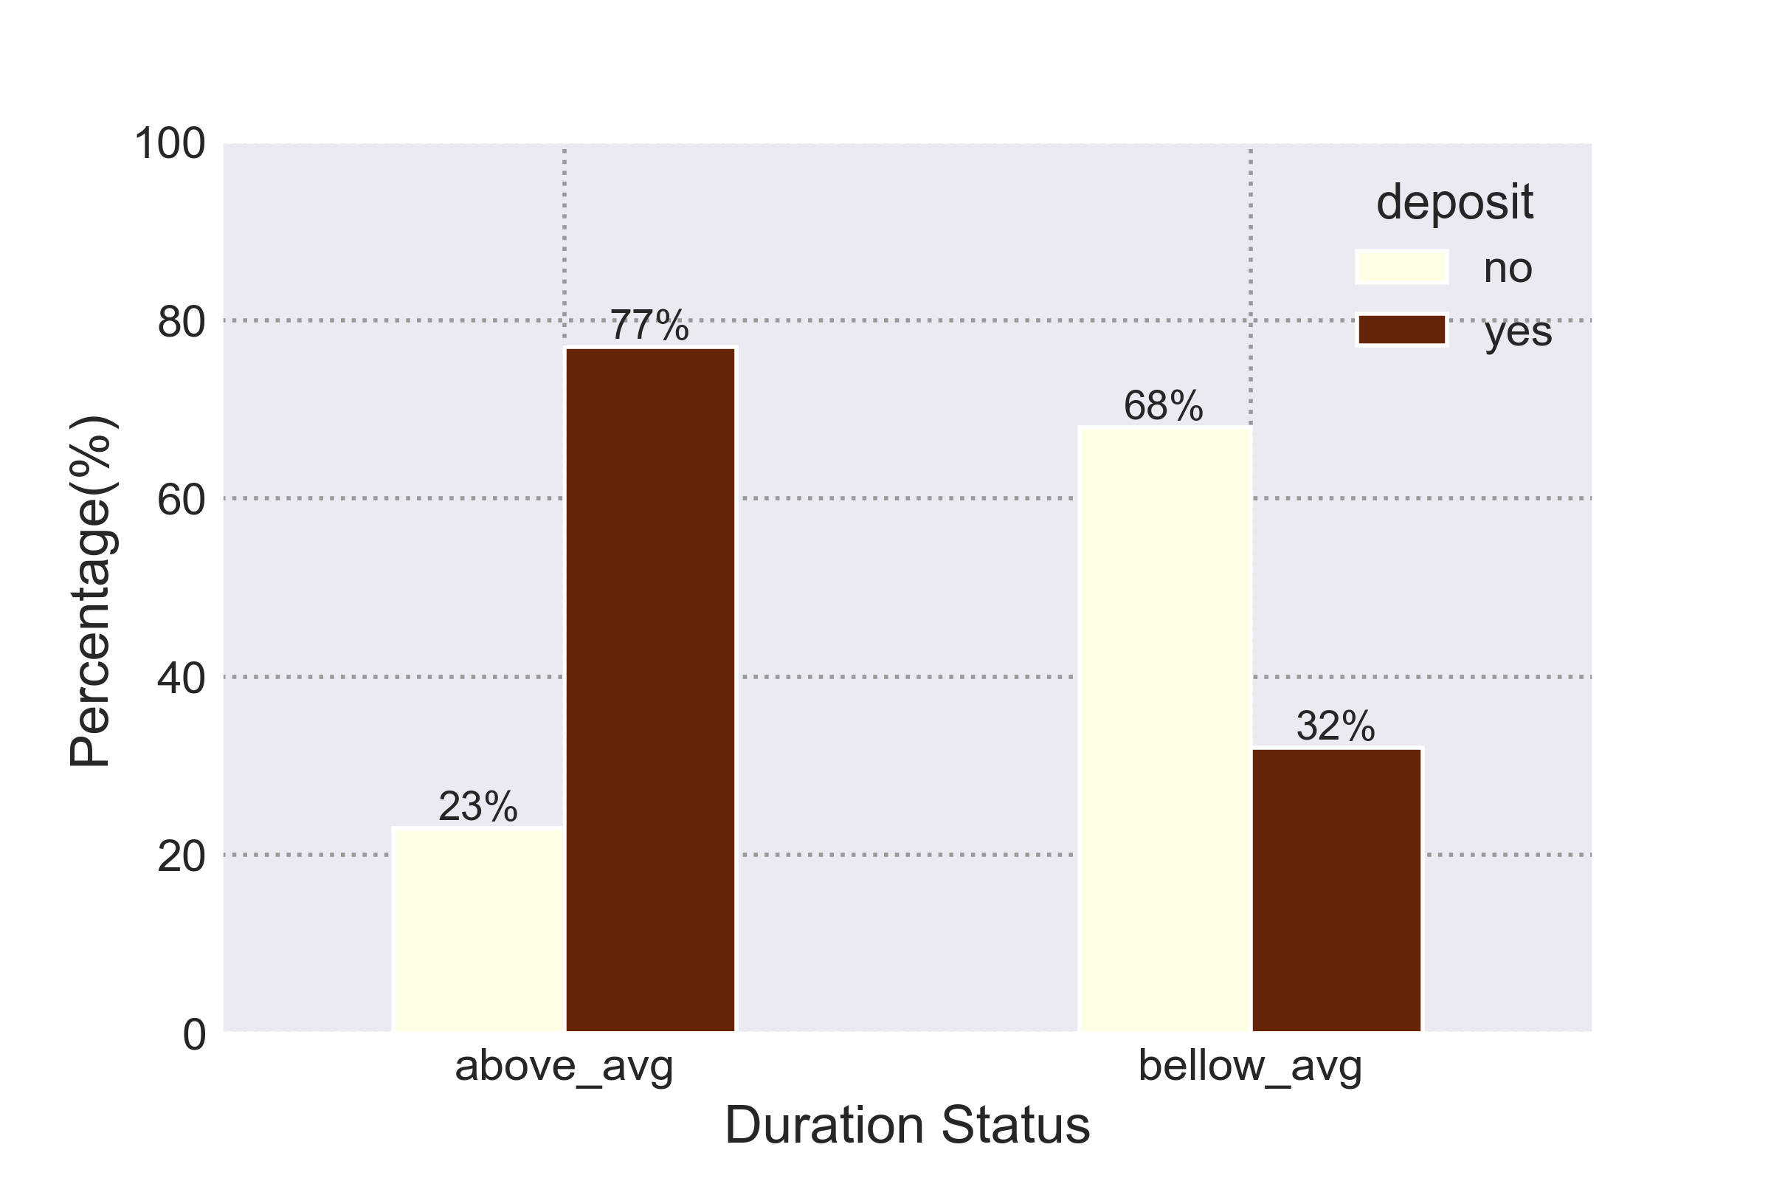
The Impact of Duration in Opening a Term Deposit
Page 11 of 21
77% of the group with durations above average (above 4,5 minute) tend to open term deposits. Whereas just 32% of the group with durations below average opened term deposit accounts.
This suggest that it will be good idea to target individuals who are in the above average category

Slide 12
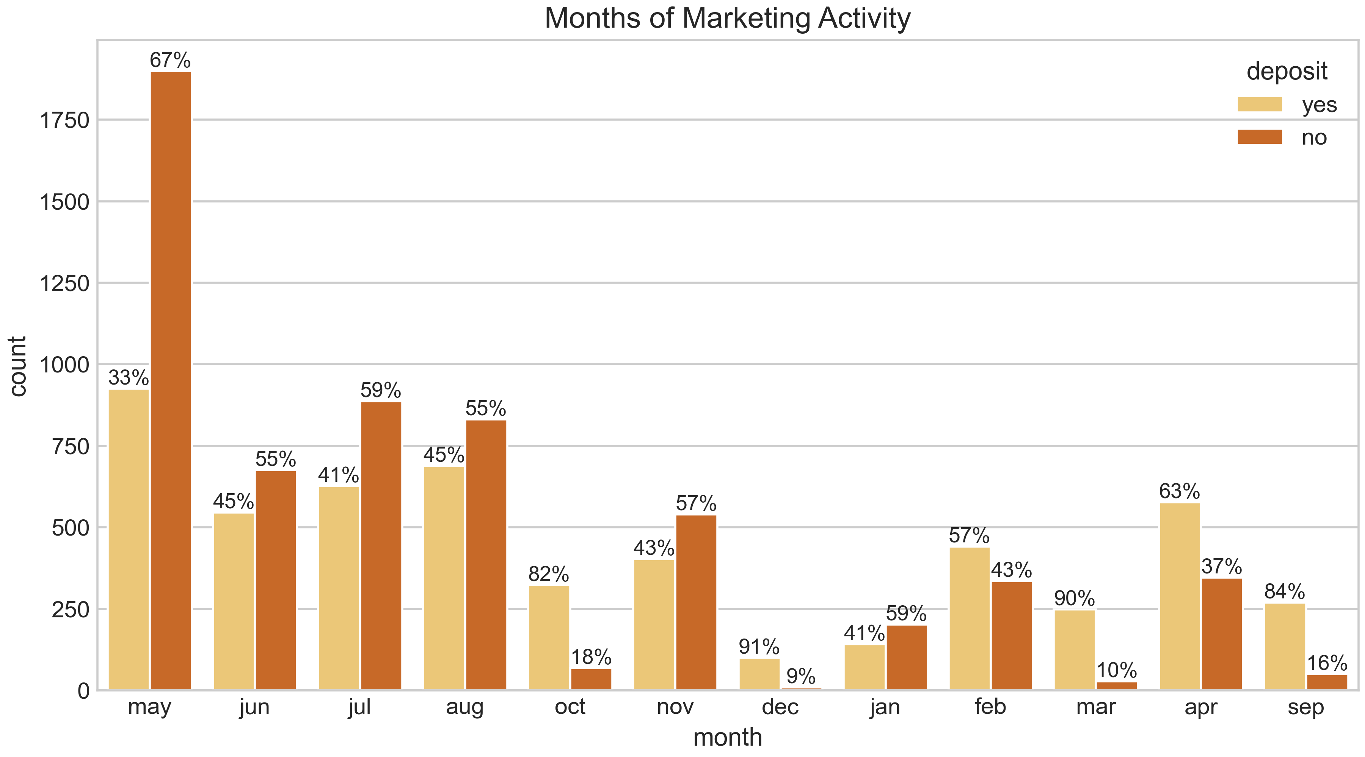
May has the highest activity marketing. However, this was the month that potential clients tended to reject term deposit offers
March, April, September, and October have the highest possibility that customers tend to subscribe term deposits offer (effective rate above 63%)
December is also has a high effective rate, but it should be taken into consideration because it was the month with the lowest marketing activity. There might be a reason why December is the lowest.
Page 12 of 21
Notes:
That's why it's recommended to carry out marketing activities at the end and beginning of the year.

Slide 13
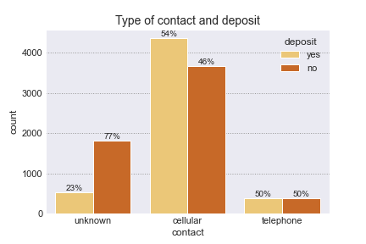
Differences in the type of communication form are not so influential in determining whether a customer will subscribe to the term deposit.
Page 13 of 21

Slide 14
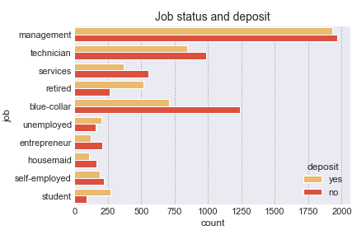
Analysis by Occupation
Page 14 of 21
Term deposits are popular among customers who are students and retired. Customers who work in blue-collar and service jobs are less likely to be interested in term deposits.

Slide 15
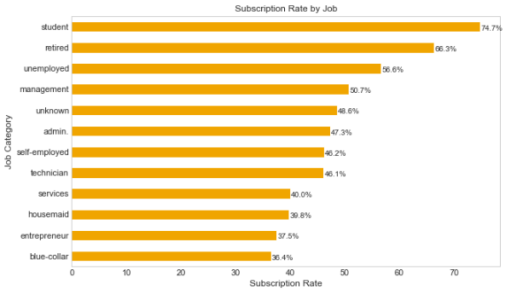
Term deposits are popular among customers who are students and retired.
Customers who work in blue-collar and service jobs are less likely to be interested in term deposits.
Page 15 of 21

Slide 16
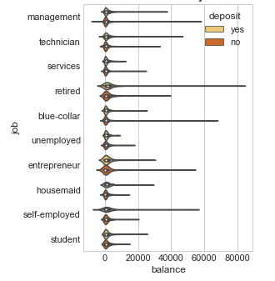
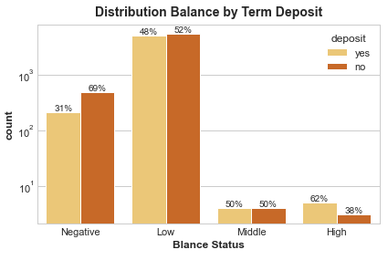
Customers with high balances (over 40,000) have a 62% chance of signing up for term deposits.
Page 16 of 21
Notes:
The youngest category had a 60% chance of suscribing to a term deposit while the eldest category had a 76% chance of suscribing to a term deposit

Slide 17
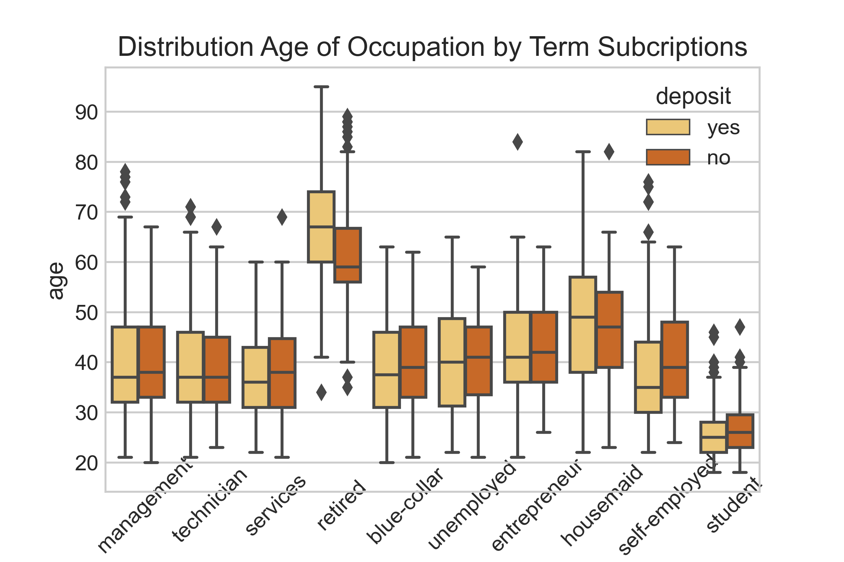
Customers who subscribed for term deposits tend to have greater balance and age values.
Page 17 of 21
Notes:
The youngest category had a 60% chance of suscribing to a term deposit while the eldest category had a 76% chance of suscribing to a term deposit

Slide 18
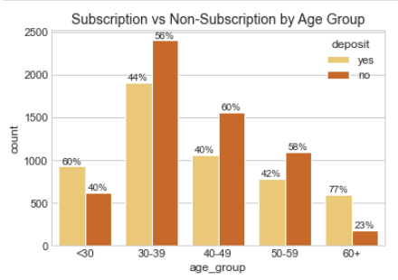
Analysis by Age
Page 18 of 21
The youngest category had a 60% chance of subscribing to a term deposit while the eldest category had a 77% chance of subscribing to a term deposit.
It will be great if for the next campaign the bank addressed these two categories and therefore, increase the likelihood of more term deposits subscriptions.

Slide 19
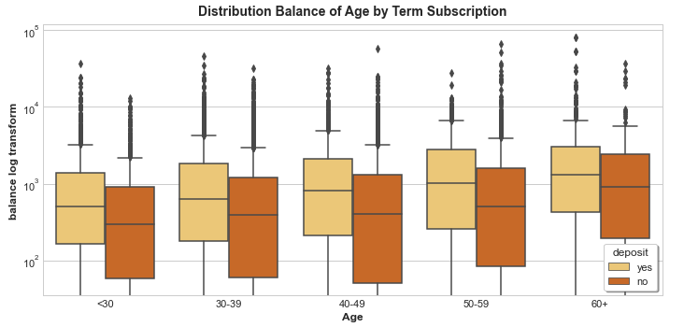
Customers who subscribed for term deposits tend to have greater balance and age values.
Page 19 of 21
Notes:
The youngest category had a 60% chance of suscribing to a term deposit while the eldest category had a 76% chance of suscribing to a term deposit

Slide 20
Recomendation
TAILORING
Page 20 of 21
The next marketing campaign of the bank it will be wise to target:
Target potential clients in their 20s or younger and 60s or older
Focus on individuals of average and high balances (over 30.000)
Potential clients that were students or retired occupation were the most likely to subscribe to a term deposit.
March, September, October, and December are the main focal months for the marketing campaign. (December should be taken into account since it had the lowest marketing activity; there may be a reason why it was the lowest.)
Target individuals with a last contact duration above 4.5 minutes (77% chance of subscribing).

Slide 21



Let's work together!
Page 21 of 21
085959511309
nabila.lailika@gmail.com
nabila-lailika-amalia
Bekasi - Indonesia
Page 21 of 21

